Slide 1
Kmeans & pca

Slide 2
unsupervised learning
K-means Clustering
Principal Component Analysis (PCA) – with focus on MD simulations

Slide 3
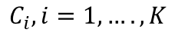
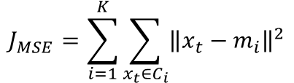

K-means clustering (Partitional)
To partition a data set N, with each data point being a collection of features, into K clusters by minimizing a mean-square-error (MSE) function.
$$J_{MSE}=\sum_{i=1}^{K}{\sum_{x_{t}∈C_{i}}{{\left\|x_{t}−m_{i}\right\|}^{2}}}$$
$$C_{i}, i=1,….,K$$
Where $m_{i}$ is the geometrical centroid of cluster $C_{i}$
and $x_{t}$ is a vector of the t-th data point in cluster $C_{i}$

Slide 4
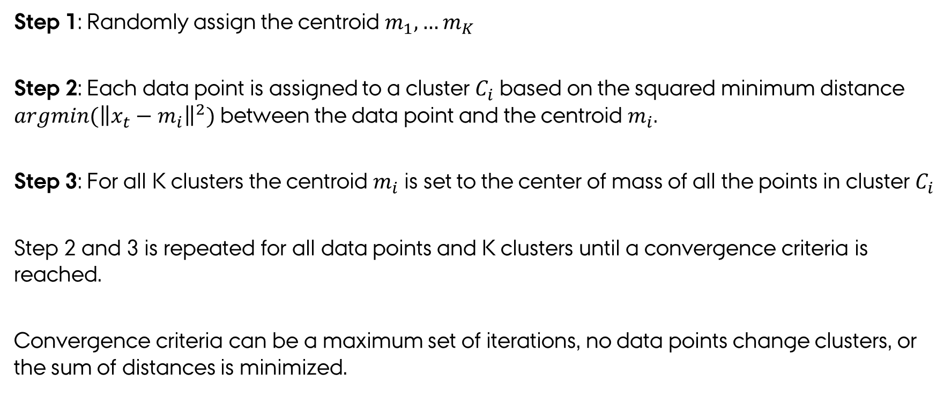
K-means clustering
Step 1: Randomly assign the centroid $m_{1},…m_{K}$
Step 2: Each data point is assigned to a cluster $C_{i}$ based on the squared minimum distance $argmin({\left\|x_{t}−m_{i}\right\|}^{2})$ between the data point and the centroid $m_{i}$.
Step 3: For all K clusters the centroid $m_{i}$ is set to the center of mass of all the points in cluster $C_{i}$
Step 2 and 3 is repeated for all data points and K clusters until a convergence criteria is reached.
Convergence criteria can be a maximum set of iterations, no data points change clusters, or the sum of distances is minimized.
Notes:
Typically used because it is simple and fast

Slide 5
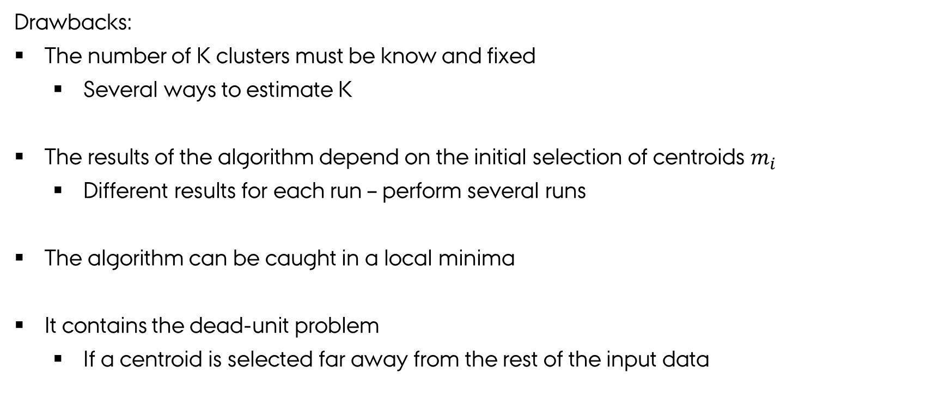
K-means clustering
Drawbacks:
The number of K clusters must be know and fixed
Several ways to estimate K
The results of the algorithm depend on the initial selection of centroids $m_{i}$
Different results for each run – perform several runs
The algorithm can be caught in a local minima
It contains the dead-unit problem
If a centroid is selected far away from the rest of the input data

Slide 6
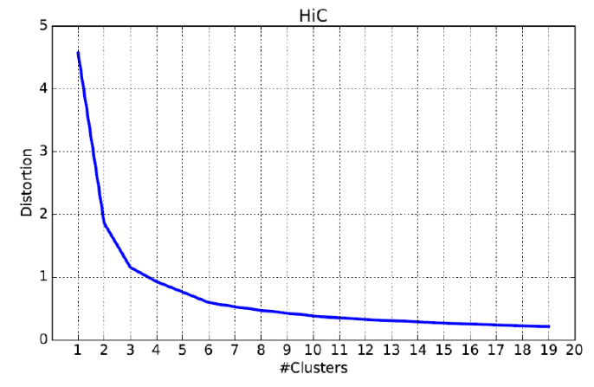
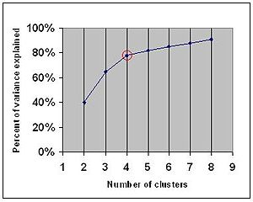
K-means clustering
One method for estimation K: The “Elbow method”, “Elbow point” or “Elbow criteria”
The distortion is the sum of the squared difference between the observations and the corresponding centroid.
Percentage of variance explained as the ratio of the between-group variance to the total variance

Slide 7
K-means clustering
Other methods for estimating K:
- Cross-validation
- G-means algorithm
- The silhouette method
- Genetic algorithm

Slide 8
K-means clustering
Treatment of input data:
It is common practice to “whiten” / normalizing the date before applying K-means algorithm.
Principal Component Analysis (PCA) for feature reduction or extraction and visualization
Notes:
Before running k-means, it is beneficial to rescale each feature dimension of the observation set with whitening. Each feature is divided by its standard deviation across all observations to give it unit variance.

Slide 9
PCA
A statistical method developed by Karl Pearson in 1901
A set of possibly correlated variables
Linear combination of uncorrelated Principal Components

Slide 10
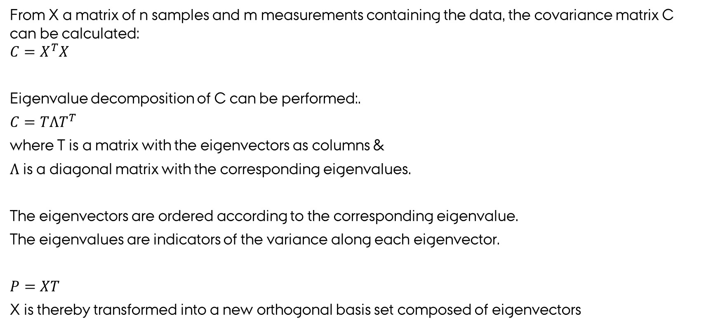
PCA
From X a matrix of n samples and m measurements containing the data, the covariance matrix C can be calculated:
$$C=X^{T}X$$
Eigenvalue decomposition of C can be performed:.
$C=TΛT^{T}$
where T is a matrix with the eigenvectors as columns &
$Λ$ is a diagonal matrix with the corresponding eigenvalues.
The eigenvectors are ordered according to the corresponding eigenvalue.
The eigenvalues are indicators of the variance along each eigenvector.
$P=XT$
X is thereby transformed into a new orthogonal basis set composed of eigenvectors
Notes:
You can chose a subset of T thereby reducing the dimension from m to r, where r equals the number of eigenvectors chosen to represent the data set.

Slide 11
PCA
Notes:
PCA is a method for simply ‘rotating’ the data space and identifying the dimensions of importance

Slide 12
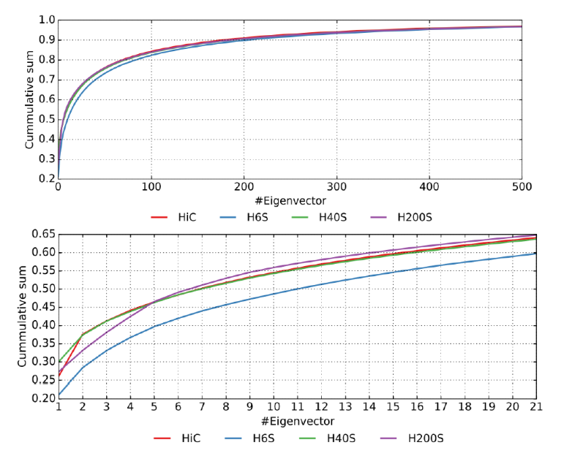
PCA
Scree plot represents the fraction of the total variance of the data as a function of eigenvectors.

Slide 13
What i did
Investigate the essential motion of a protein along with clustering of the sampled structures.
- Calculated the PCs and projected the trajectory along the first 4 eigenvectors
- Performed K-means clustering on the projection
- ”Back traced” the clustering to the space of my measurements (X) thereby clustering the sampled structures of the protein

Slide 14
PCA - drawbacks
In case of MD simulation:
Depend on the sampling – cosine content
Concatenated trajectories might result in artefacts
Considered the data you use – The first PC might not be of relevance
For MD remove any translation and rotation of the protein, in order for the PCA to capture the internal motions

Slide 15
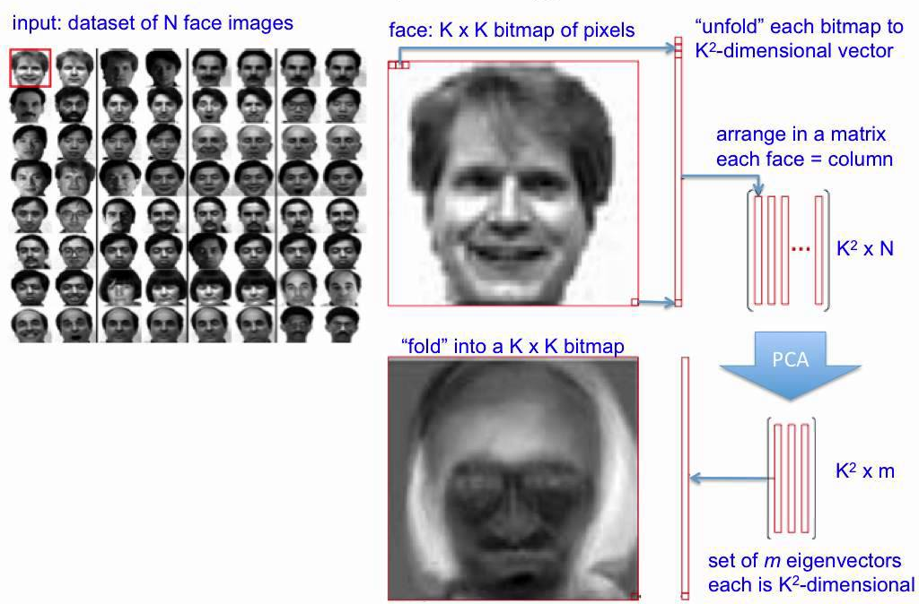
PCA for facial recognition
https://www.youtube.com/watch?v=_lY74pXWlS8

